Slide 1
Data Science Lecture 2 Data Collection: Design of Experiment
Shuen-Lin Jeng
Dept. of Statistics and Inst. of Data Science
NCKU
2023/09/16

Slide 2
Data Science Work Jeff Hammerbacher’s Model
1. Identify problem
2. Instrument (select and organize) data sources
3. Collect data
4. Prepare data (integrate, transform, clean, ﬁlter, aggregate)
5. Build model
6. Evaluate model
7. Communicate results

Slide 3
Example: Supermarket Decision Variables
A large supermarket association wished to more scientifically determine some of its strategies concerning the allocation of shelf space to products, product pricing, product promotion, and location of products within the supermarket.
In this regard, the association decided to sponsor an experiment that examined these “managerial decision variables” (as they put it).
1. Geography (eastern vs. western part of the U.S.)
2. Volume category of the product
3. Price category of the product
4. Degree of seasonality of the product
5. Amount of shelf space allocated to the product
6. Price of the product
7. Amount of promotion of the product
8. Location quality of the product

Slide 4
Financial Services Menu
GlobalFinServe hoped to resolve many questions using the results of the experiment. The primary issue was to determine which benefits and services would drive demand to join the special client group.
Using the company’s information on the different costs it would incur for the different levels of each factor, a cost/benefit analysis could then be done.
1.Dedicated financial relationship manager?
Yes; one specific person will be familiar with your profile, serve your needs, and proactively
make recommendations to you
No; there is a pool of people, and you are served by whoever answers the phone; no
proactive recommendations
2. Availability of separate dedicated centers at which clients and financial relationship
managers can meet?: Yes; No
3. Financial services availability
About ten different levels of services available; for example, investment services and
financial planning services available, but borrowing services not available
4. Cost to the special client: $20 per year; $200 per year; 0.5% of assets per year
5. Minimum account balance (total of investments and deposits): $25,000; $50,000; $100,000

Slide 5
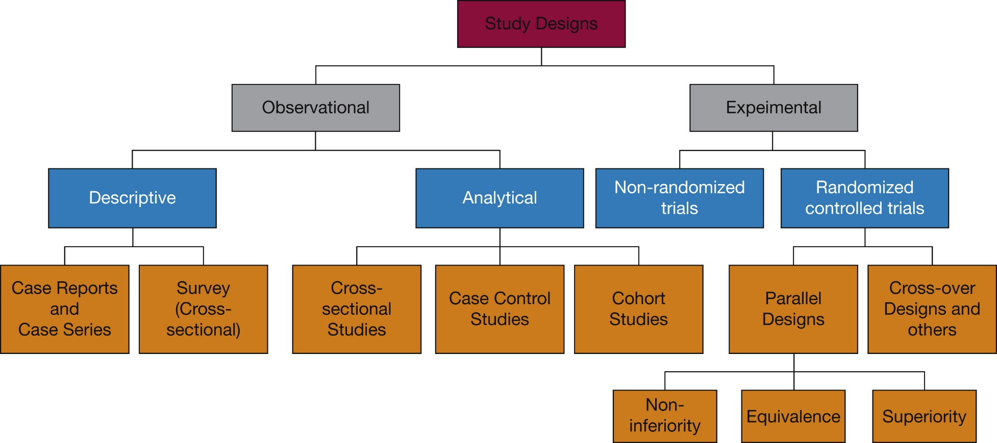
Clinical Research and More

Slide 6
Purpose (Goal) of “Design of Experiment”
A study of the experiment methods for a corresponding specific topic to acquire the critical informant and reduce the cost of the experiment.
A study of the data analysis on the outcome of the experiment to provide causal inference and decision support.
Typical application fields include agriculture, medical research, pharmaceutical study, manufacturing industry, management, business, and others which require experiments to collect the data.

Slide 7
Strategy of Experimentation
“Best-guess” experiments
Used a lot
More successful than you might suspect, but there are disadvantages…
One-factor-at-a-time (OFAT) experiments
Sometimes associated with the “scientific” or “engineering” method
Devastated by interaction, also very inefficient
Statistically designed experiments
Based on Fisher’s factorial concept

Slide 8
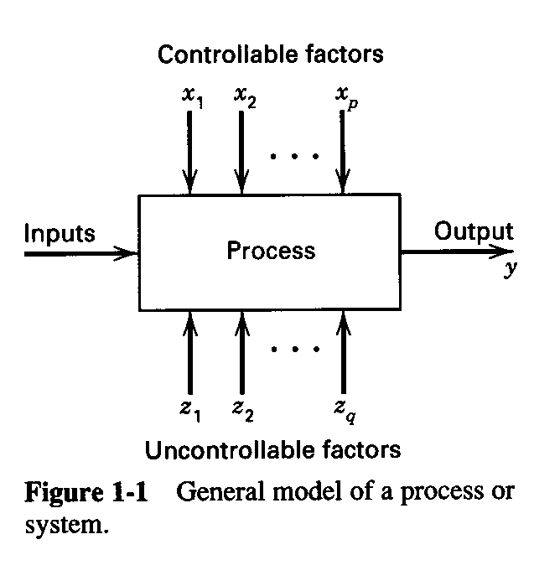
Engineering Experiments
Reduce time to design/develop new products & processes
Improve performance of existing processes
Improve reliability and performance of products
Achieve product & process robustness
Evaluation of materials, design alternatives, setting component & system tolerances, etc.

Slide 9
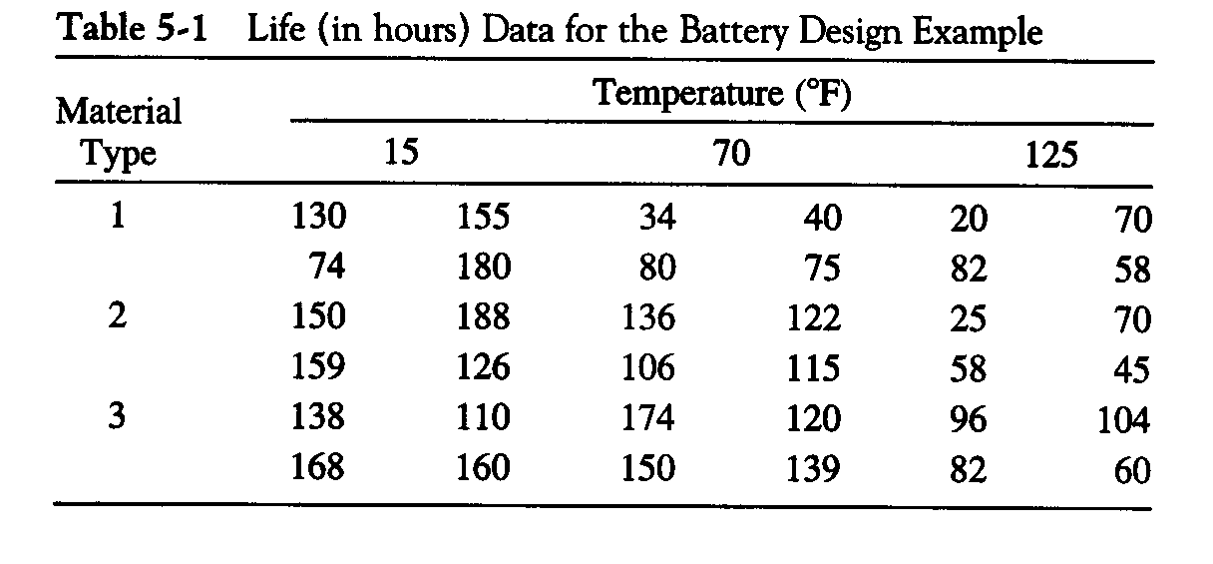
The Battery Life Experiment A Factorial Design
A = Material type; B = Temperature (A quantitative variable)
1. What effects do material type & temperature have on life?
2. Is there a choice of material that would give long life regardless of temperature (a robust product)?

Slide 10
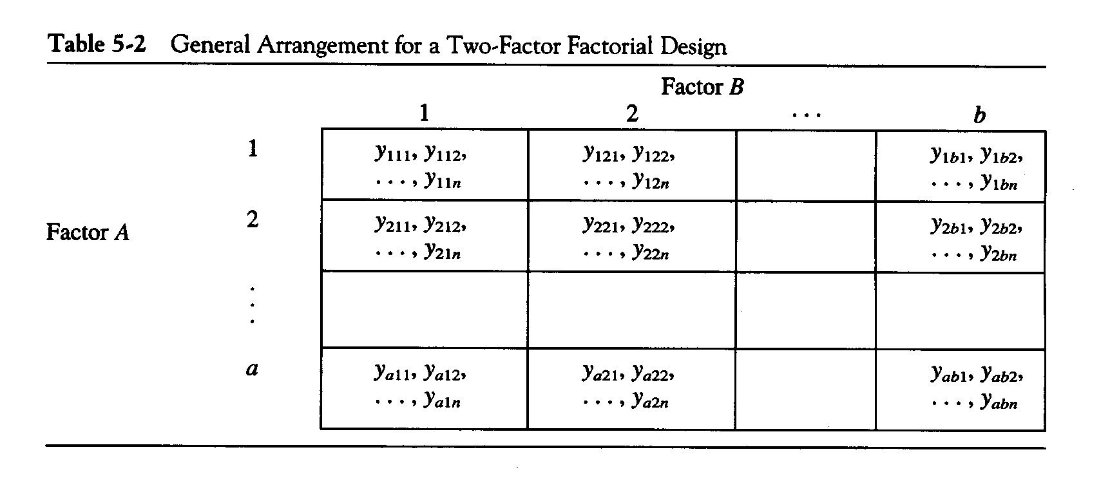
a levels of factor A; b levels of factor B; n replicates
This is a completely randomized design

Slide 11
The Basic Principles of DOX
Key words:
Treatments (conditions): combination of factor levels (Material type; Temperature)
Experimental unit: the subject that the treatment applies to (battery)
Three Important Principles:
(1) Randomization
How: Running the treatments in random order
Why: Balancing out effects of “lurking” variables, to explore cause-and-effect relationship

Slide 12
The Basic Principles of DOX
Three Important Principles:
(2) Replication
How: 1. Several experimental units for each treatment. 2. Repeat treatments for different unit several times. 3. Run the whole experiment several times
Why: Obtain larger sample size to improve precision of effect estimation, estimation of error or background noise
It is different from repeat measurement
(3) Blocking
How: Partition treatments into several blocks
Why: Dealing with nuisance factors

Slide 13
Battery life experiment
One statistical (effects) model: parameters are the factor effects
Other models (means model, regression models) can be also useful

Slide 14
Analysis of Variance (ANOVA)
Estimators of the parameters?

Slide 15
Analysis of Variance (ANOVA)
(1)
(2)
(3)

Slide 16
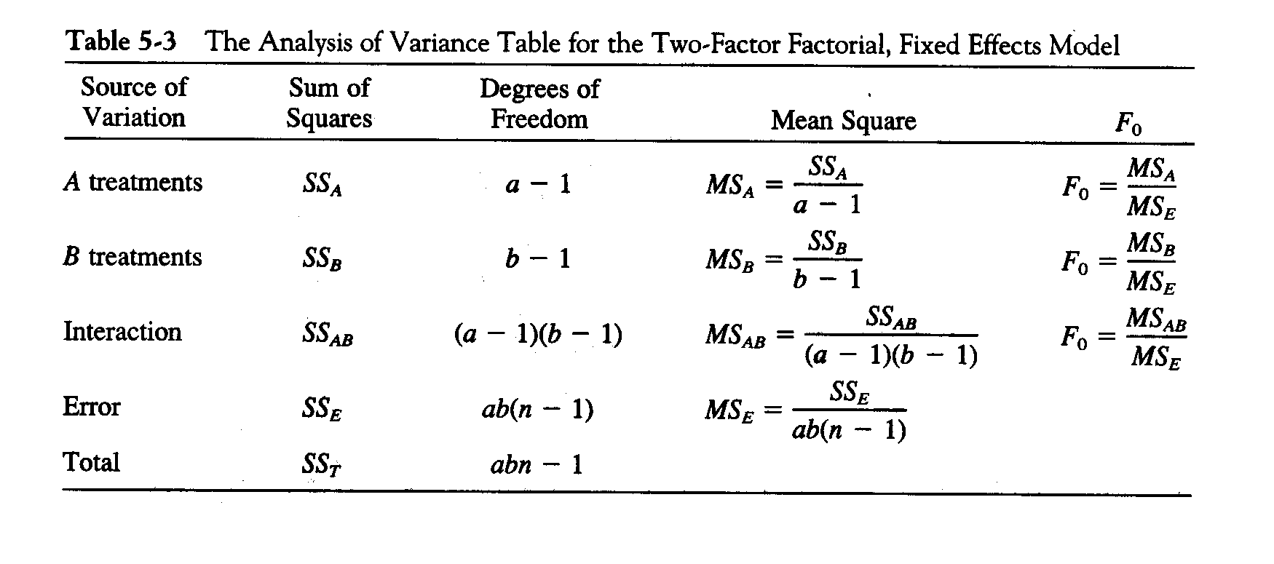
Analysis of Variance (ANOVA)

Slide 17
Analysis of Variance (ANOVA)
Response: Life ANOVA for Selected Factorial Model Analysis of variance table [Partial sum of squares]
Sum of Mean F Source Squares DF Square Value Prob > F Model 59416.22 8 7427.03 11.00 < 0.0001 A 10683.72 2 5341.86 7.91 0.0020 B 39118.72 2 19559.36 28.97 < 0.0001 AB 9613.78 4 2403.44 3.56 0.0186 Pure E 18230.75 27 675.21 C Total 77646.97 35
Std. Dev. 25.98 R-Squared 0.7652 Mean 105.53 Adj R-Squared 0.6956 C.V. 24.62 Pred R-Squared 0.5826
PRESS 32410.22 Adeq Precision 8.178

Slide 18
Analysis of Variance (ANOVA)
Is the ANOVA table enough for the
data analysis of an experimet?
As a statistician or data scientist, the
answer is …..

Slide 19
Data Visualization

Slide 20
Analysis of Variance (ANOVA)

Slide 21
Analysis of Variance (ANOVA)

Slide 22
Analysis of Variance (ANOVA)

Slide 23
If the runs were not randomized and there is a “lurking” variable…
Suppose the experiment was run in the order of the rows: from first row to the last row.
And there is a decay effect of the equipment (“lurking” variable):
72 (This is the first run) 70 68 66 64 62 60 58 56 54 52 50 48 46 44 42 40 38 36 34 32 30 28 26 24 22 20 18 16 14 12 10 8 6 4 2 (This is the last run)
The batteries will have a longer life in the early run (72 hours more) and shorter life in the latter run.
Df Sum Sq Mean Sq F value Pr(>F)
Material 2 4172 2086 3.122 0.0603 .
Temperature 2 99407 49703 74.387 1.04e-11 ***
Material:Temperature 4 9614 2403 3.597 0.0178 *
Residuals 27 18041 668
Material effect is not significant now!

Slide 24
If the runs were randomized and there is a “lurking” variable…
Suppose the experiment was run in random order of the rows: from first row to the last row.
And there is a decay effect of the equipment (“lurking” variable):
56 54 50 58 30 60 36 26 44 18 4 12 22 70 72 (This is the second run) 48 8 46 24 62 14 52 38 28 10 64 2 (this is the last run) 34 6 16 72 (This is the first run) 32 20 42 40 66 68
The batteries will have a longer life in the early run.
Df Sum Sq Mean Sq F value Pr(>F)
Material 2 8646 4323 3.669 0.0389 *
Temperature 2 37922 18961 16.095 2.5e-05 ***
Material:Temperature 4 16664 4166 3.536 0.0191 *
Residuals 27 31809 1178
Material effect is still significant!
The randomization had balanced out the effects of “lurking” variables

Slide 25
Blocking in the 2^K Experiment
Blocking is a technique for dealing with controllable nuisance variables
Two cases are considered
Replicated designs
Unreplicated designs
If there are n replicates of the design, then each replicate is a block
Each replicate is run in one of the blocks (time periods, batches of raw material, etc.)
Runs within the block are randomized

Slide 26
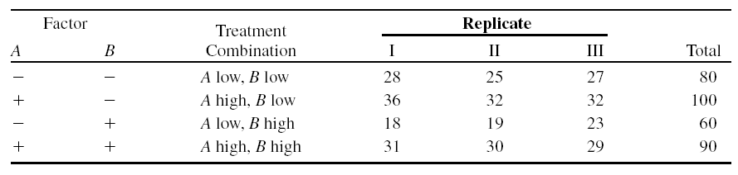
Chemical Process Example
One regular design: completely randomized design
A = reactant concentration, B = catalyst amount, y = recovery

Slide 27
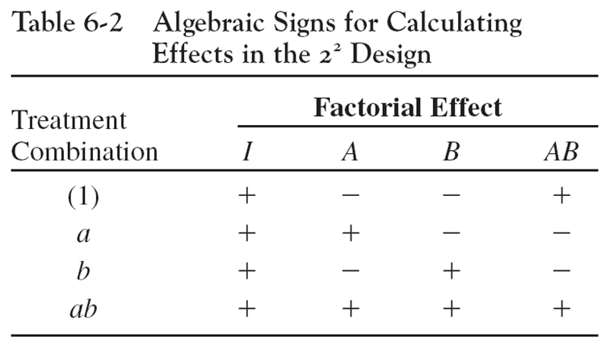
Chemical Process Example

Slide 28
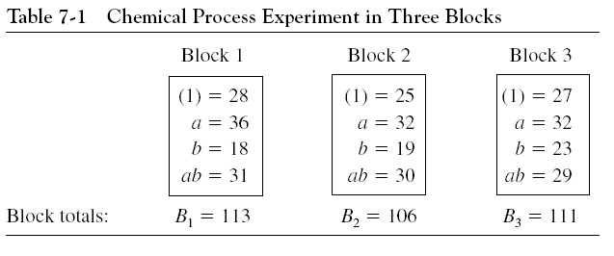
Blocking a Replicated Design
The typical blocks are time periods (day or week),
batches of raw material (catalyst batches)

Slide 29
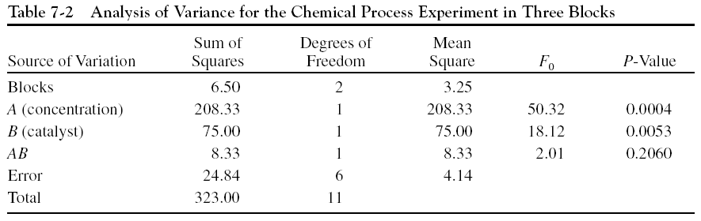
ANOVA for the Blocked Design

Slide 30
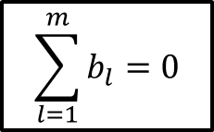
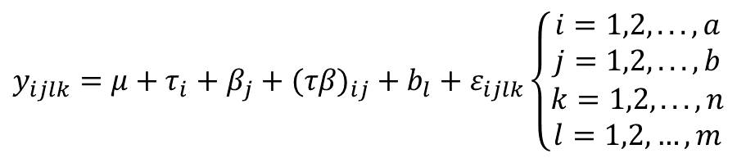
Battery life experiment Blocked Design
One statistical (effects) model: parameters are the factor effects and block effect
$$y_{ijlk}=μ+τ_{i}+β_{j}+(τβ)_{ij}+b_{l}+ε_{ijlk}\left\{\begin{matrix}i=1,2,...,a \\ j=1,2,...,b \\ \begin{aligned}k=1,2,...,n \\ l=1,2,…,m\end{aligned}\end{matrix}\right.$$
$$\sum_{l=1}^{m}{b_{l}=0}$$

Slide 31
ANOVA for the Blocked Design

Slide 32
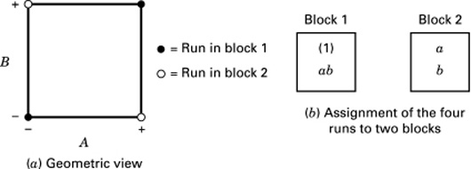
Unreplicated Case
Clearly the previous discussion does not apply, since there is only one replicate

Slide 33
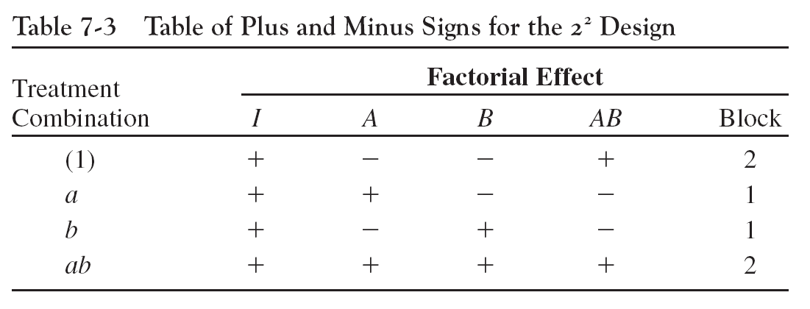
Unreplicated Case

Slide 34
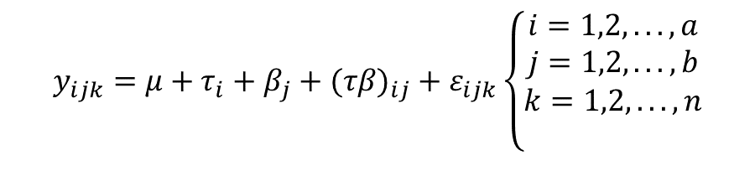
Unreplicated Case
One statistical (effects) model: parameters are the factor effects
a=2, b=2, k=1. The interaction effect is equal to the block effect
$$y_{ijk}=μ+τ_{i}+β_{j}+(τβ)_{ij}+ε_{ijk}\left\{\begin{matrix}i=1,2,...,a \\ j=1,2,...,b \\ \begin{aligned}k=1,2,...,n \\ \end{aligned}\end{matrix}\right.$$

Slide 35
Unreplicated Case ANOVA
a=2, b=2, k=1. The interaction effect is equal to the block effect

Slide 36
The Two-Factor Factorial with Random Factors
The model parameters are normally distributed random variables.
The parameter represents a sample from a population.
Random effects model.

Slide 37
Test Factor Effects
Relevant hypotheses
Form of the test statistics depend on the expected mean squares:

Slide 38
Estimate the factor variance
As before, use the ANOVA method; equate expected mean squares to their observed values:

Slide 39
A Measurement Systems Capability Study
Gauge capability (or R&R) is of interest
The gauge is used by an operator to measure a critical dimension on a part
Repeatability is a measure of the variability due only to the gauge
Reproducibility is a measure of the variability due to the operator
This is a two-factor factorial (completely randomized) with both factors (parts, operators,) random – a random effects model

Slide 40
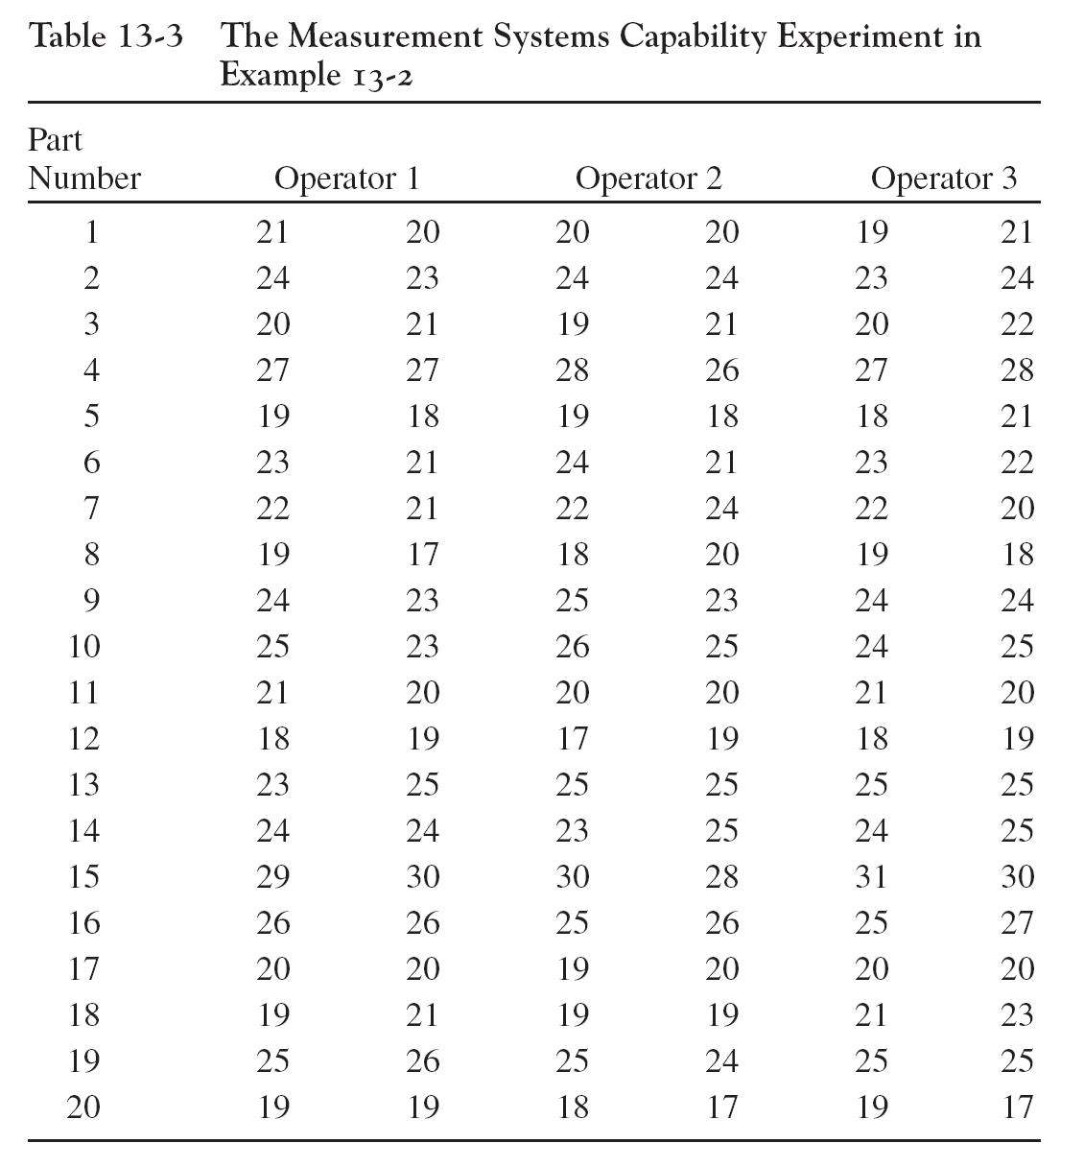
A Measurement Systems Capability Study: Product Length

Slide 41
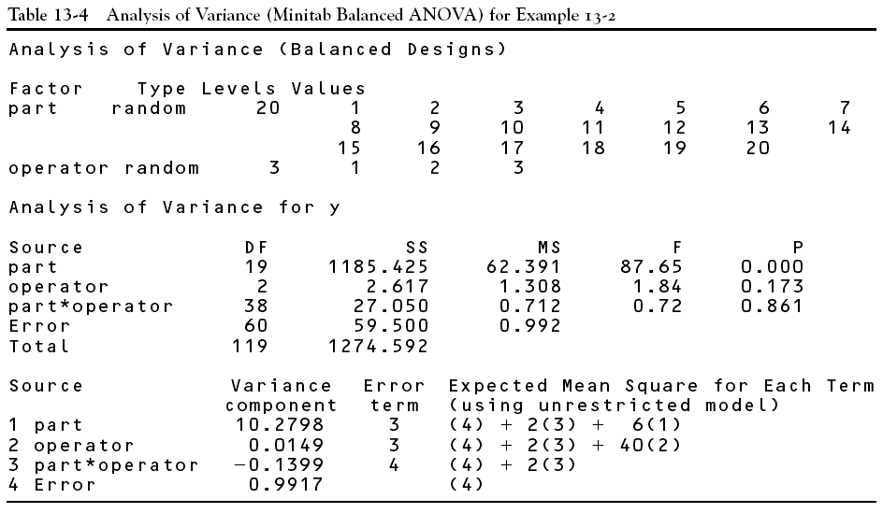
A Measurement Systems Capability Study

Slide 42

Gauge Capability
The estimate of the variance component of parts (τ), operator (β) (Reproducibility), and measurement equipment (Repeatability) and the gauge capability
$${\hat{σ}}_{τ}^{2}=\frac{62.391−0.712}{3x2}=10.279$$ ${\hat{σ}}_{β}^{2}=\frac{1.308−0.712}{20x2}=0.0149$ (Reproducibility)
${\hat{σ}}^{2}=0.992$ (Repeatability)
${\hat{σ}}_{gauge}^{2}=$ ${\hat{σ}}^{2}$+ ${\hat{σ}}_{β}^{2}=0.992+0.0149=1.0069$

Slide 43
Reference 1. Design and Analysis of Experiment. By Montgomery. Wiley.

